Slide 1
Welcome
Bismilllahhir Rahmanir Rahim
Hosted and prepared by
MD. SOROWAR MAHABUB RABBY
Department of CSE (Computer Science and Engineering) , IIUC
Cell: 01834756433, 01521564157
E-mail: sorowarmahabub1709vip@gmail.com

Slide 2
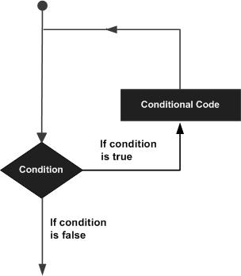
Loop in C Language
The looping can be defined as repeating the same process multiple times until a specific condition satisfies. There are three types of loops used in the C language. In this part, we are going to learn all the aspects of C loops.

Slide 3
Advantage of loops in C
1) It provides code reusability.
2) Using loops, we do not need to write the same code again and again.
3) Using loops, we can traverse over the elements of data structures (array or linked lists).

Slide 4
Types of loop
There are 3 types of Loop in C language, namely:
while loop
for loop
do while loop

Slide 5
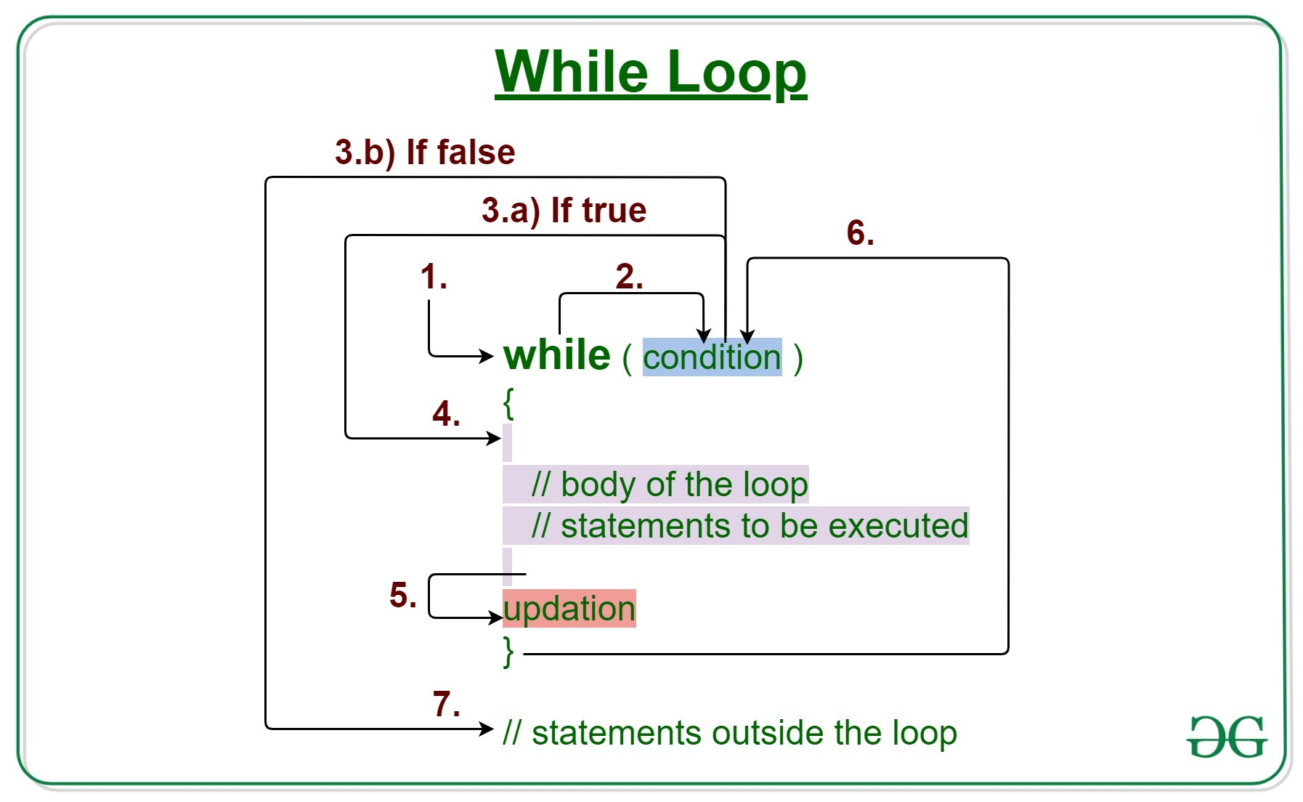
while loop

Slide 6
while loop Intro
while loop can be addressed as an entry control loop. It is completed in 3 steps.
Variable initialization. (e.g int x = 0;)
condition (e.g while(x <= 10))
Variable increment or decrement ( x++ or x-- or x = x + 2 )

Slide 7
while loop Syntax
variable initialization; while(condition) {
statements;
variable increment or decrement;
}

Slide 8
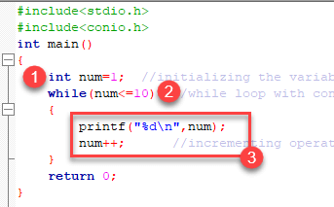
while loop Example 1
Output:
1
2
3
4
5
6
7
8
9
10

Slide 9
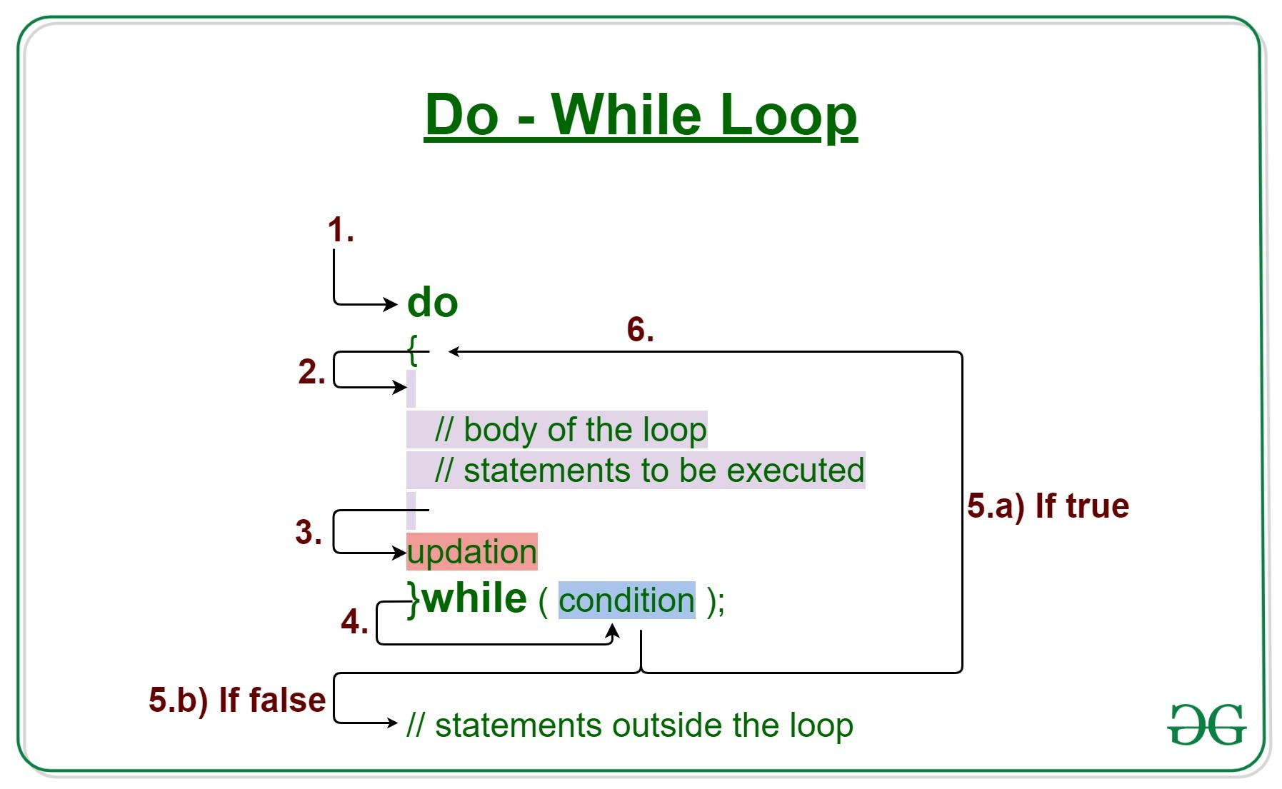
do while loop

Slide 10
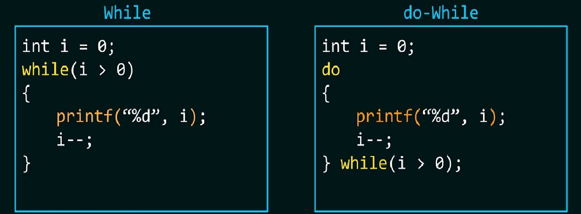
While & do while loop

Slide 11
do while loop Intro
In some situations it is necessary to execute body of the loop before testing the condition. Such situations can be handled with the help of do-while loop. do statement evaluates the body of the loop first and at the end, the condition is checked using while statement.

Slide 12
do while loop Syntax
It means that the body of the loop will be executed at least once, even though the starting condition inside while is initialized to be false. General syntax is,
do {
..... .....
} while(condition)

Slide 13
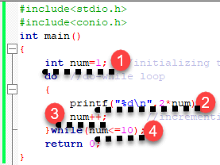
do while loop Example 1
Output:
2
4
6
8
10
12
14
16
18
20

Slide 14
do while loop Example 2
//Example: Program to print first 10 multiples of 5.
#include<stdio.h>
void main() {
int a, i;
a = 5; i = 1;
do {
printf("%d\t", a*i);
i++;
} while(i <= 10);
}
Output:
5 10 15 20 25 30 35 40 45 50

Slide 15
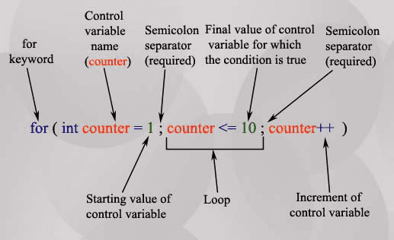
for loop

Slide 16
for loop Intro
In for loop we have exactly two semicolons, one after initialization and second after the condition. In this loop we can have more than one initialization or increment/decrement, separated using comma operator. But it can have only one condition.
The for loop is executed as follows:
It first evaluates the initialization code.
Then it checks the condition expression.
If it is true, it executes the for-loop body.
Then it evaluate the increment/decrement condition and again follows from step 2.
When the condition expression becomes false, it exits the loop.

Slide 17
for loop Syntax
for loop is used to execute a set of statements repeatedly until a particular condition is satisfied. We can say it is an open ended loop.. General format is,
for(initialization; condition; increment/decrement)
{
statement-block;
}

Slide 18
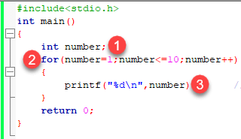
for loop Example 1
Output:
1
2
3
4
5
6
7
8
9
10

Slide 19
for loop Example 2
// Example: Program to print first 10 natural numbers
#include<stdio.h>
void main( ) {
int x;
for(x = 1; x <= 10; x++) {
printf("%d\t", x);
}
return 0:
}
Output:
1 2 3 4 5 6 7 8 9 10

Slide 20
Nested for loop Syntax
We can also have nested for loops, i.e one for loop inside another for loop. Basic syntax is,
for(initialization; condition; increment/decrement)
{
for(initialization; condition; increment/decrement)
{
statement ;
}
}

Slide 21
nested for loop Example
//Example: Program to print half Pyramid of numbers
#include<stdio.h>
void main( ) {
int i, j;
/* first for loop */
for(i = 1; i <= 5; i++) {
printf("\n");
/* second for loop inside the first */
for(j = i; j > 0; j--) {
printf("%d", j);
}
}
}
Output:
1
21
321
4321
54321

Slide 22
The Infinite Loop
A loop becomes an infinite loop if a condition never becomes false.
When the conditional expression is absent, it is assumed to be true. You may have an initialization and increment expression, but C programmers more commonly use the for(;;) construct to signify an infinite loop.
Obukk, then what can we do to stop a loop….?

Slide 23
Loop Control Statements
Loop control statements change execution from its normal sequence. When execution leaves a scope, all automatic objects that were created in that scope are destroyed.
C supports the following control statements.
Sr.No. | Control Statement & Description
1 | break statement Terminates the loop or switch statement and transfers execution to the statement immediately following the loop or switch.
2 | Continue statement Causes the loop to skip the remainder of its body and immediately retest its condition prior to reiterating.
3 | auto statement Transfers control to the labeled statement.

Slide 24
Loop Control Statements (break)
The break statement in C programming has the following two usages −
When a break statement is encountered inside a loop, the loop is immediately terminated and the program control resumes at the next statement following the loop.
It can be used to terminate a case in the switch statement (covered in the next chapter).
If you are using nested loops, the break statement will stop the execution of the innermost loop and start executing the next line of code after the block.
The syntax for a break statement in C is as follows −
break;

Slide 25
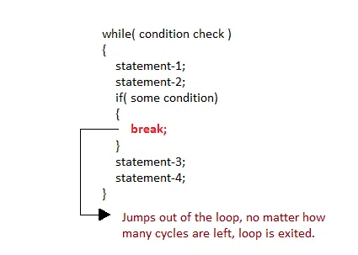
Loop Control Statements (break)

Slide 26
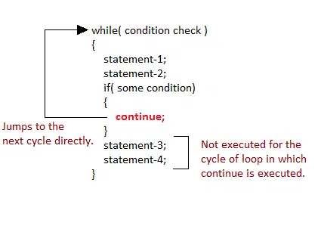
Loop Control Statements (continue)

Slide 27
Loop Control Statements (continue, goto)
Will be available in pdf in Google Classroom, Okay…?
More about nested loop
PDF in Google Classroom
&
https://www.programtopia.net/c-programming/docs/nested-loop

Slide 28
Obuk, ajk sesh hbe!?
Any questions?
Please,
Anyone answer/ explain.

Slide 29
Chat এ লিখে পেল দ্রুত!
Kn loop ta brtter mne hlo……....?

Slide 30

Thanks
(Jajakallah Khairan)

